Slide 1
Structure and Function
Of Female Reproductive
System
1. Primary reproductive organs - produce ova
2. Accessory ducts - transfer ova and sperm
3. Accessory glands - add secretions
4. External genitalia - receive sperm from male

Slide 2
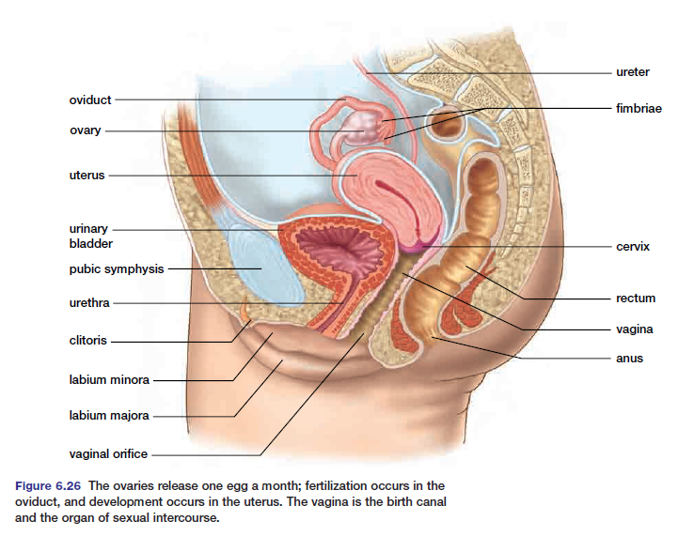

Slide 3
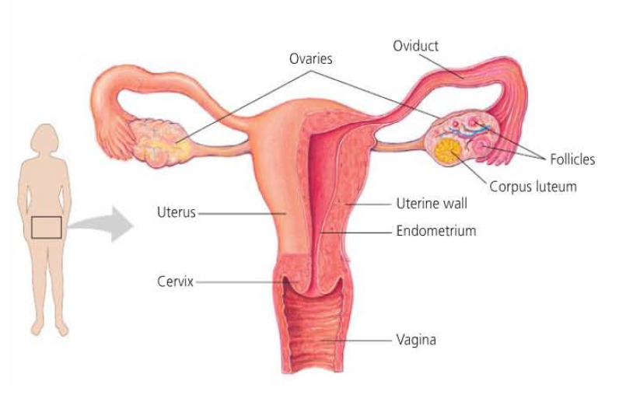

Slide 4
(1) The Ovaries - 2 Functions
(1) Produce eggs from follicles
(2) Produces estrogen (from follicles) & progesterone (from corpus luteum.
(2) The fallopian tubes (Oviducts)
- connected to uterus & lie close to ovaries
- lined with cilia & surrounded by circular muscles
- purpose - (1) to propel egg toward uterus
(2) to serve as site of fertilization.
(3) Uterus (womb) - thick-walled, muscle lining - pear-shaped
- lined with a layer called the endometrium
- site of development of embryo.

Slide 5
(4) Cervix
- entrance to uterus
- path for sperm to swim through
- produces mucin strands to facilitate sperm
- also holds baby in the uterus
(5) Vagina
- birth canal
- receptacle for male’s penis
(6) Clitoris
- sensitive organ analogous to male’s penis
- responsible for stimulating female orgasm

Slide 6
FEMALE CYCLES AND HORMONE CONTROL
1. Anterior Pituitary - makes 2 hormones that act on the ovaries
a) FSH - Follicle Stimulating Hormone - stimulates the follicle to mature and causes it to produce estrogen
b) LH - Leutinizing Hormone - maintains the corpus luteum and causes it to produce progesterone
- these are the Gonadotrophic Hormones (FSH & LH)
- they regulate the ovary’s production of female sex hormones
2. Ovary - makes 2 hormones that act on the endometrium (uterus lining)
a) Estrogen (made by the follicle)
b) Progesterone (made by the corpus luteum)

Slide 7
The Female cycles
- there are two cycles ->
i) Ovarian cycle
ii) Menstrual cycle

Slide 8
i) Ovarian cycle (28 days average)
Days 1-13 Folicular Phase
-FSH released from ant. pit.
- stimulates the development of a follicle (unfertilized egg)
- follicle begins to secrete estrogen , so the level of this hormone steadily increased
Day 14
- Ovulation - follicle releases egg (a peak of LH from ant. pit. stimulates this)
Day 15-28 Luteal Phase
- follicle turns into corpus luteum
- LH from ant. pit. stimulates the production of progesterone
- as progesterone increases, ant. pit. decreased LH so corpus luteum begins to degenerate
- when corpus luteum is gone, menstruation occurs

Slide 9
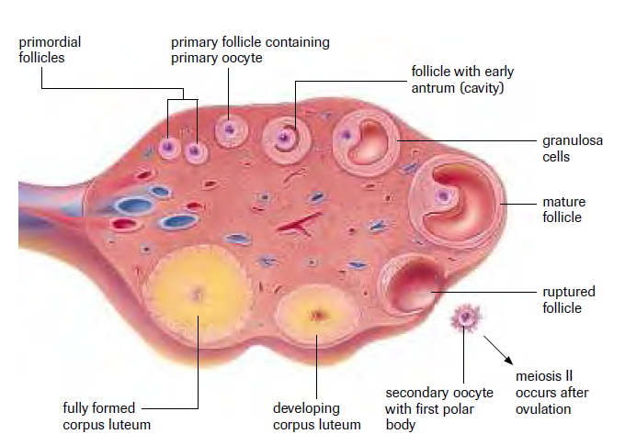
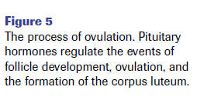

Slide 10
ii) Menstrual Cycle
Days 1-5
- low level of estrogen and progesterone
- cause thickened uterine lining to degenerate and shed menstruation “period’
Days 6-13
- estrogen (from follicle) is increasing which causes a thickening of the uterus wall (endometrium)
- extra blood vessels and glands
Day 14
- Ovulation
Day 15-28
- increased levels of progesterone causes endometrium to thicken further (2x) and thick mucous secretion
- endometrium is ready to receive fertilized egg (zygote)

Slide 11
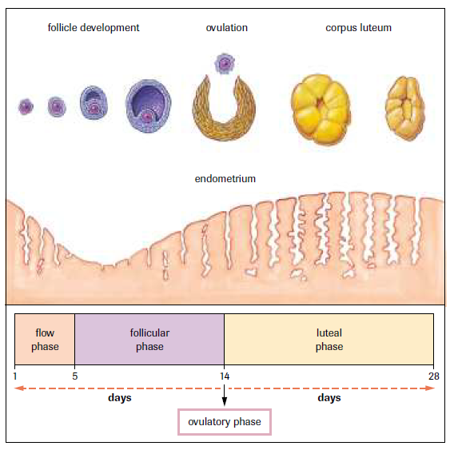

Slide 12
NORMALLY ->
- egg is not fertilized therefore corpus luteum begins to degenerate therefore progesterone falls
- low progesterone and estrogen cause endometrium to be shed. Menstruation begins
Note: if pregnancy occurs, the zygote imbeds in the thick endometrium and prevents the corpus luteum from degenerating. This keeps up progesterone levels and prevents the endometrium (and zygote from being shed.

Slide 13
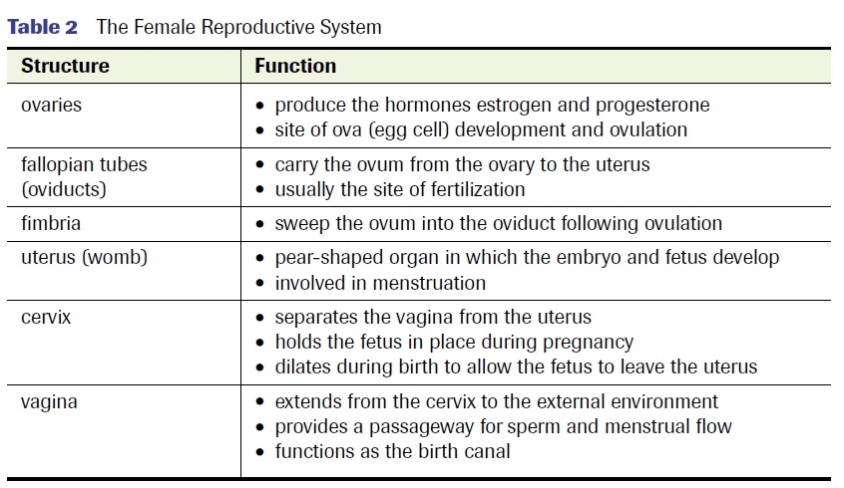

Slide 14
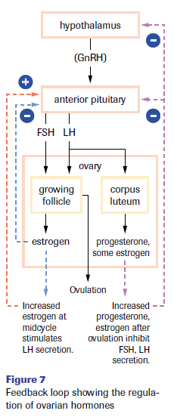

Slide 15
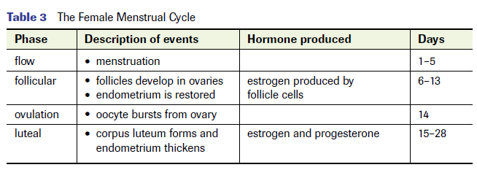

Slide 16
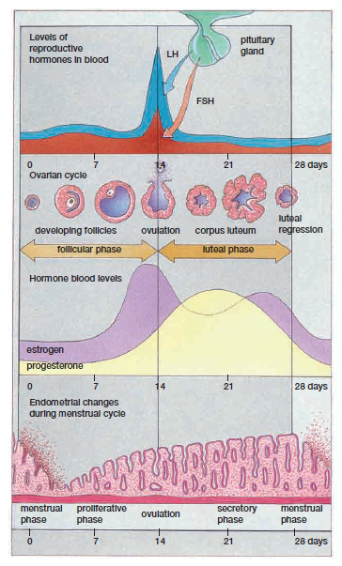

Slide 17
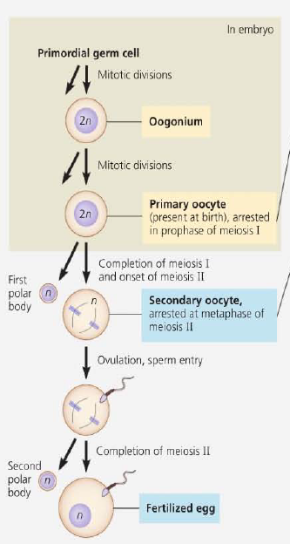
OOGENESIS:
Development of mature
oocytes (eggs)

Slide 18
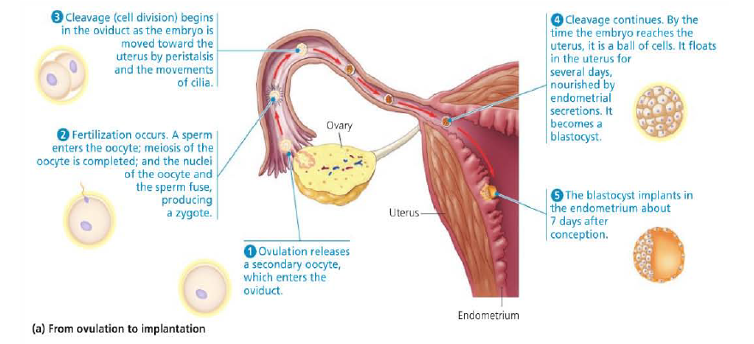

Slide 19
HOMEWORK
Trace the path of sperm through the male reproductive system, including the glands that contribute material to semen.
Describe the structure of a testis and give a function for each part.
Describe the function of a sperm and give a function for each part.
Discuss the relationship between the gonadotrophic hormones (FSH and LH) and the sex hormone testosterone and sperm production. Be sure to mention negative feedback in your discussion.
Give the path of the egg. Where does fertilization and implantation occur?
Describe the events and hormonal control of the ovarian cycle.
Describe the events and hormonal control of the uterine cycle.
How is menstruation prevented if pregnancy occurs?

